Slide 1

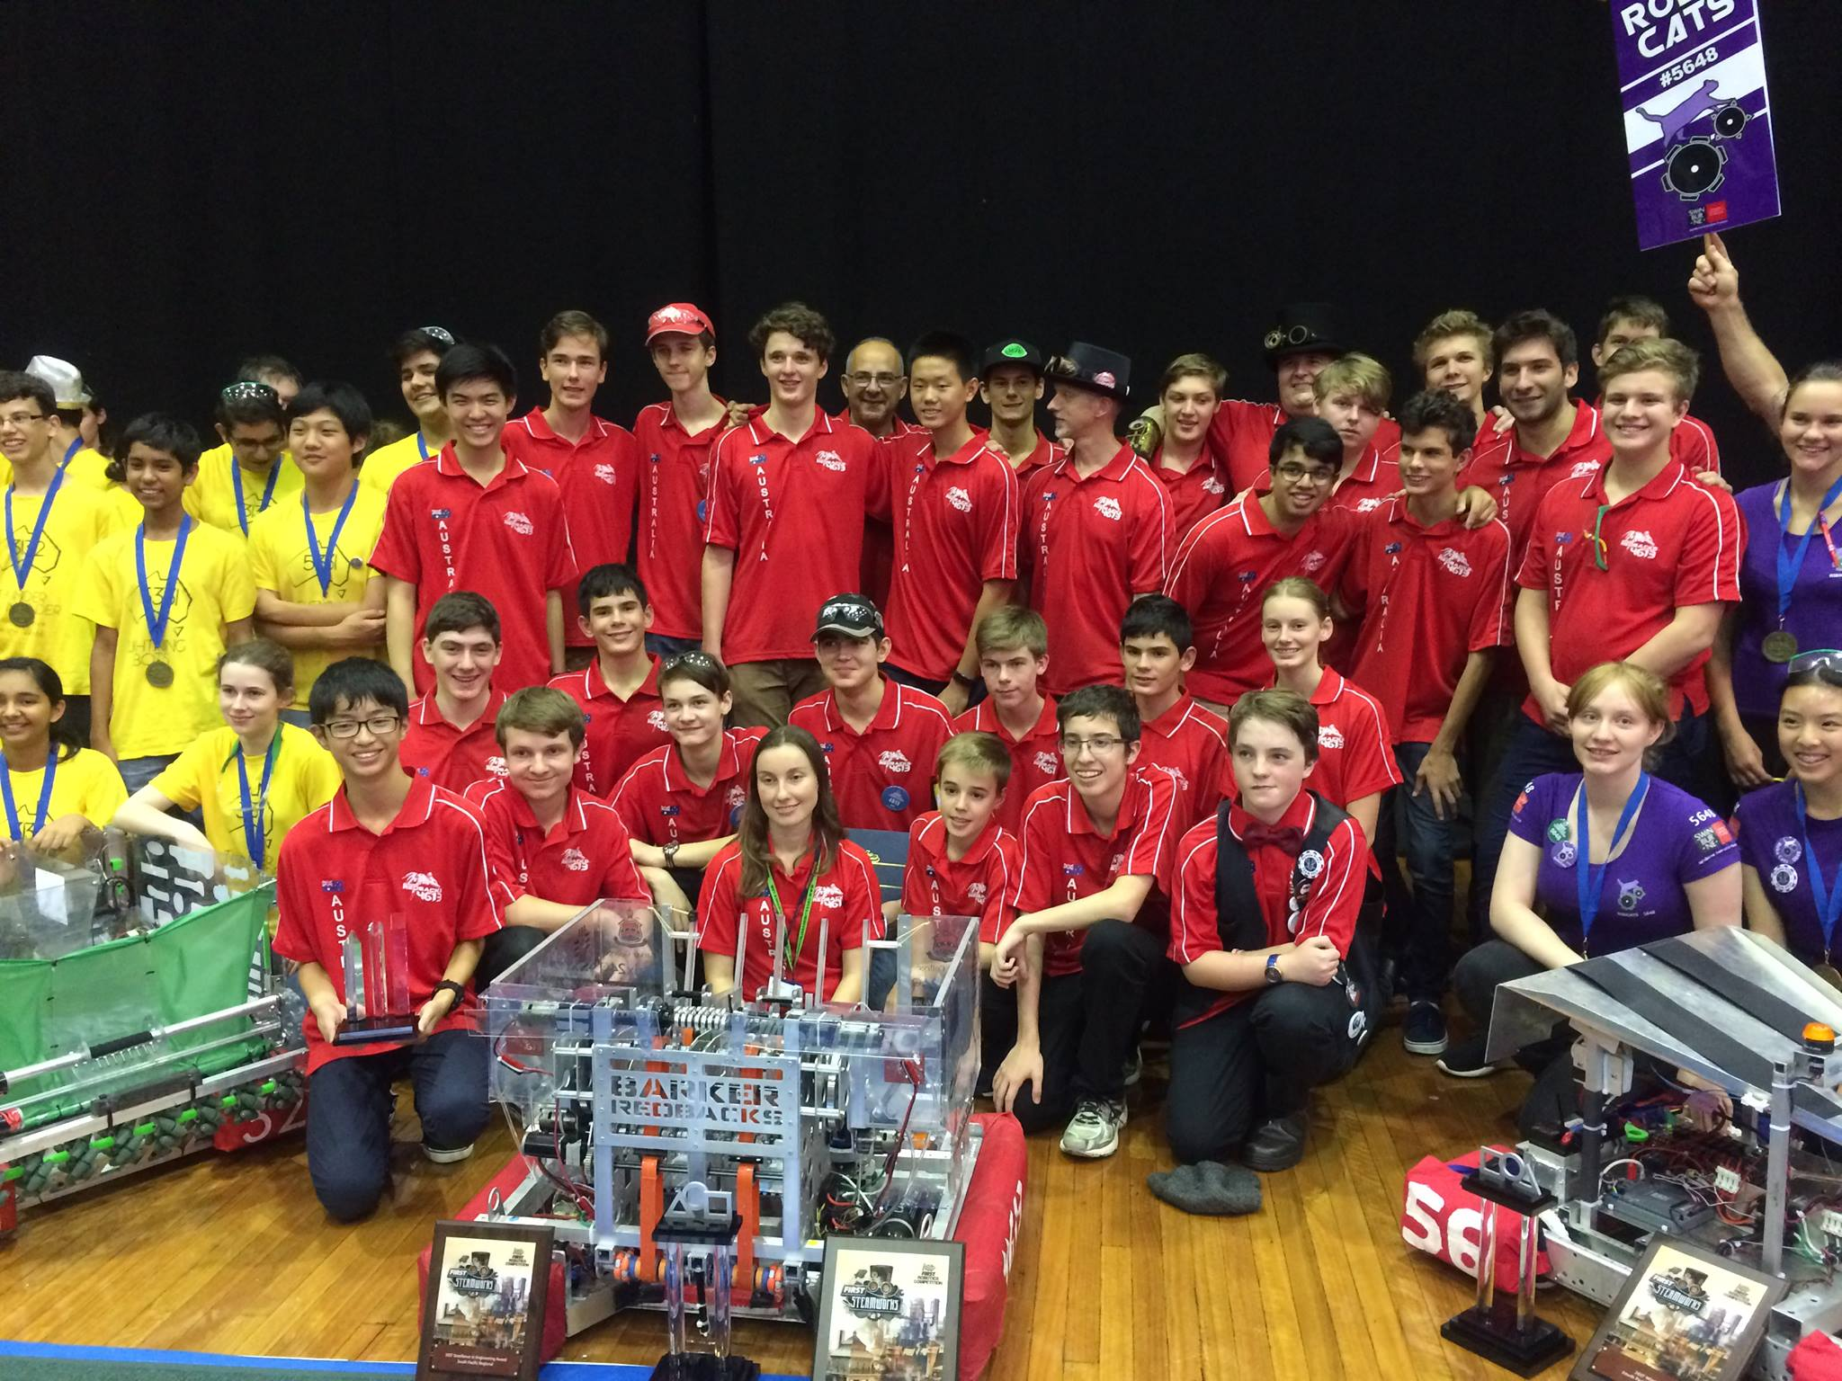
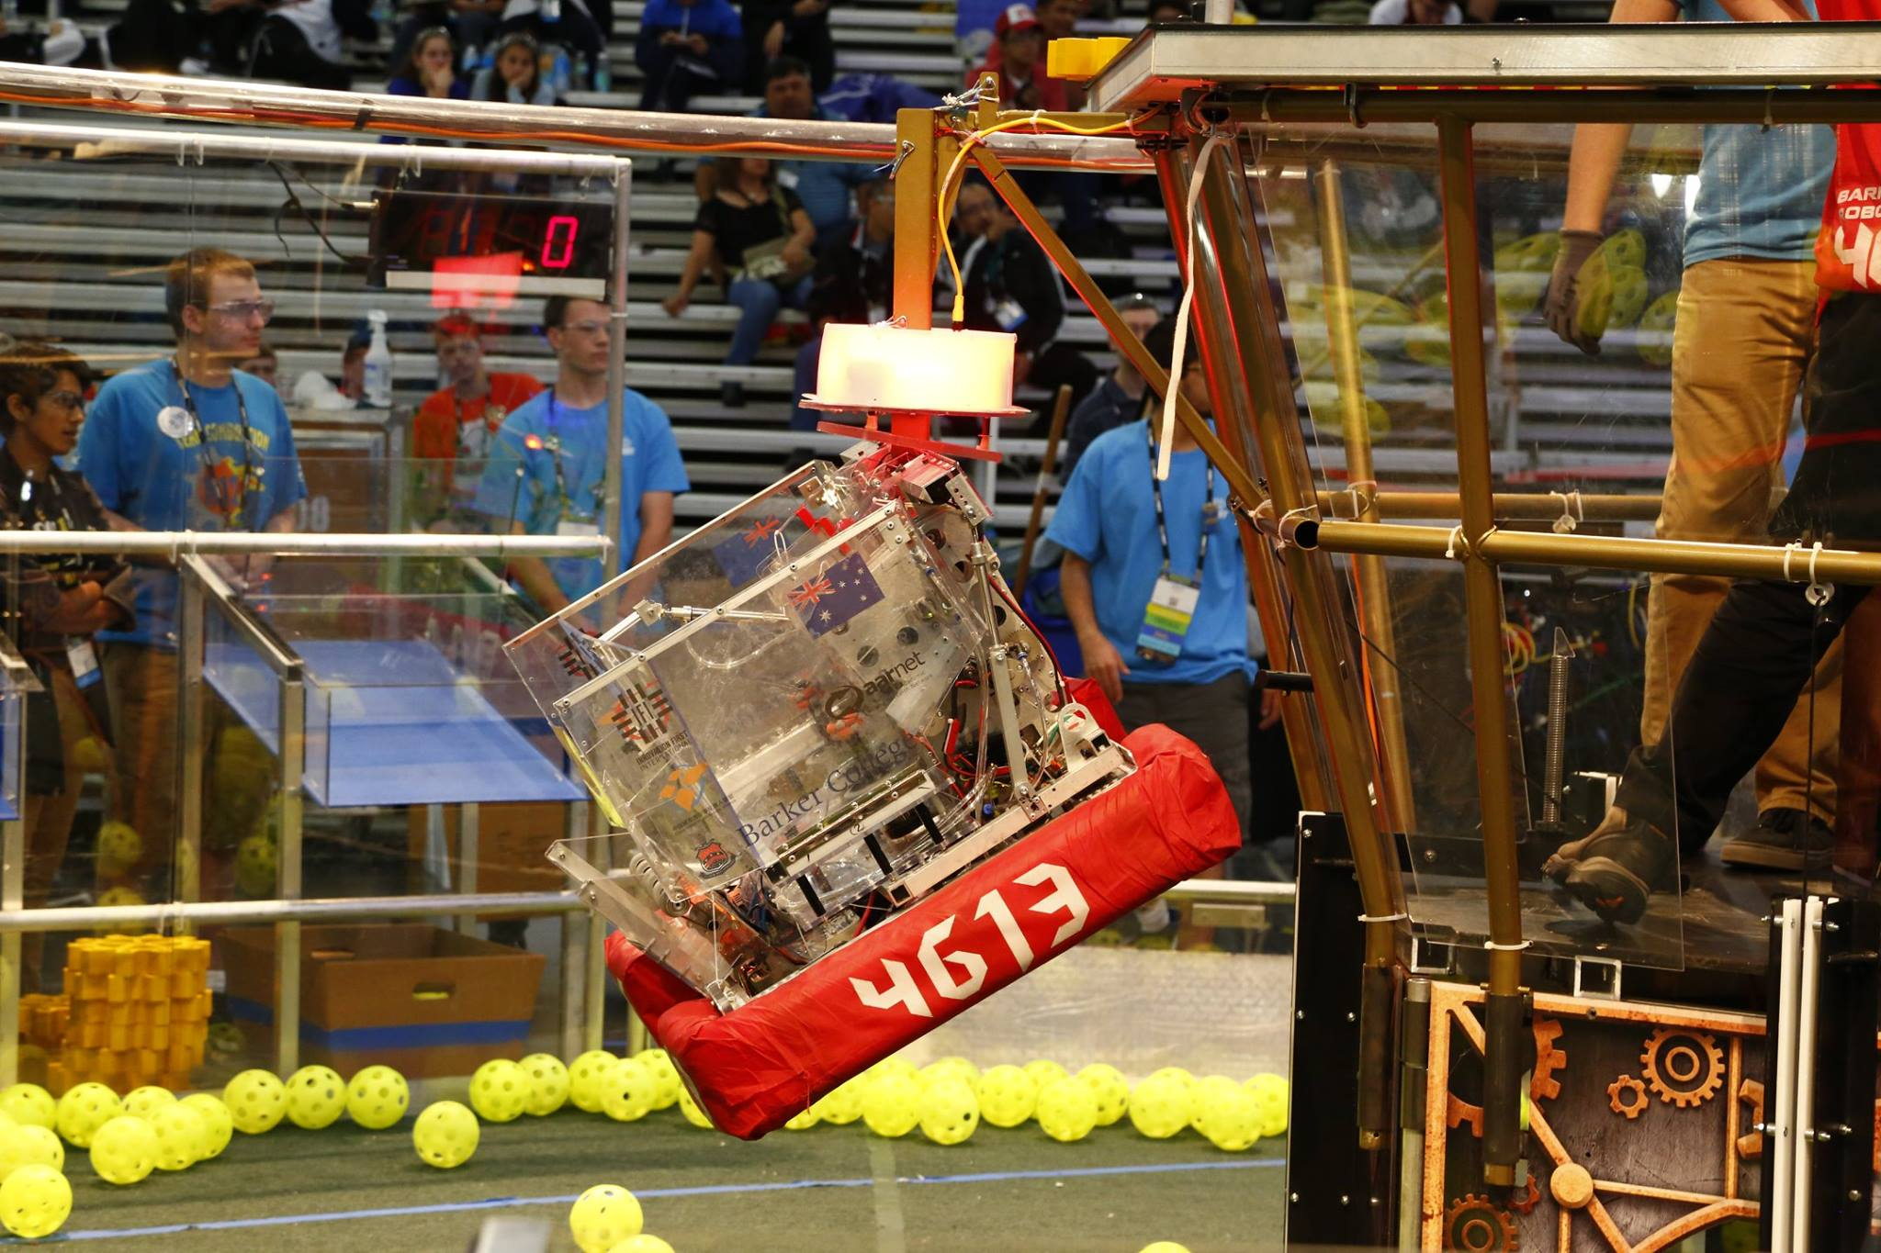
Introduction to (Java) Programming 11 – Object Oriented Programming (OOP) Theory
Matthew Brian

Slide 2

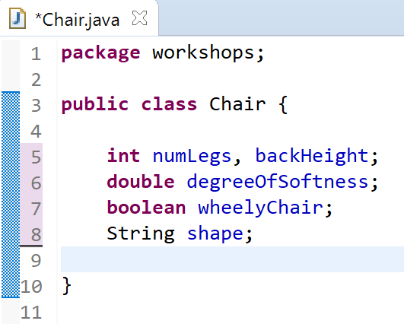
Lesson 11: OOP
To first create an object we need an object to create, in this case – we will create a Chair class, in which we will make a blueprint for a chair.
Once we have done that we need to give the Chair class attributes, lay out the characteristics that all chairs have
This is, in essence, what it means to be a chair
Each of these variables make up a chair. As these variables are a part of an object, we call each of them a field
This code may bring with it the realisation of what classes and objects are, especially if you have been grappling with what I told you in the theory
Can you really create an object this easily? Yes. Yes you can.

Slide 3
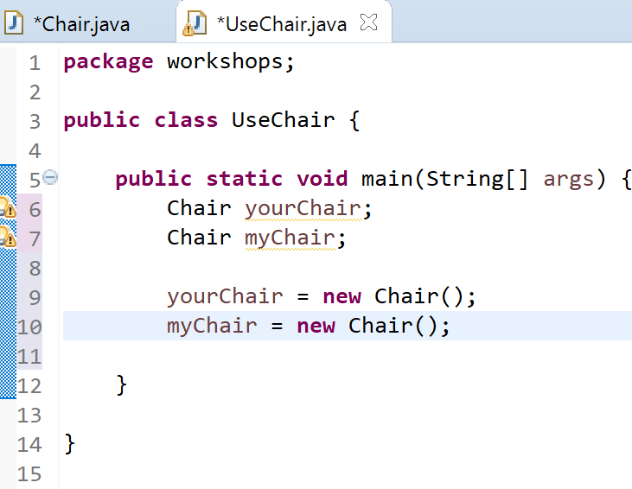
Lesson 11: OOP
We want to be able to interact with a chair right now right? So create a new class called UseChair with a main method.
Within the UseChair class’ main method, create a new instance of a chair

Slide 4
Lesson 11: OOP
Some read this first line as meaning, “yourChair is a chair” but that’s not what it means
In this first line we are instead declaring an object to exist, we haven't actually made it yet. All this does is reserve variable name yourChair so that it can eventually refer to an instance of the Chair class
The creation of the objects for official use don’t come until we execute the lines below
Object type
Object/variable name

Slide 5
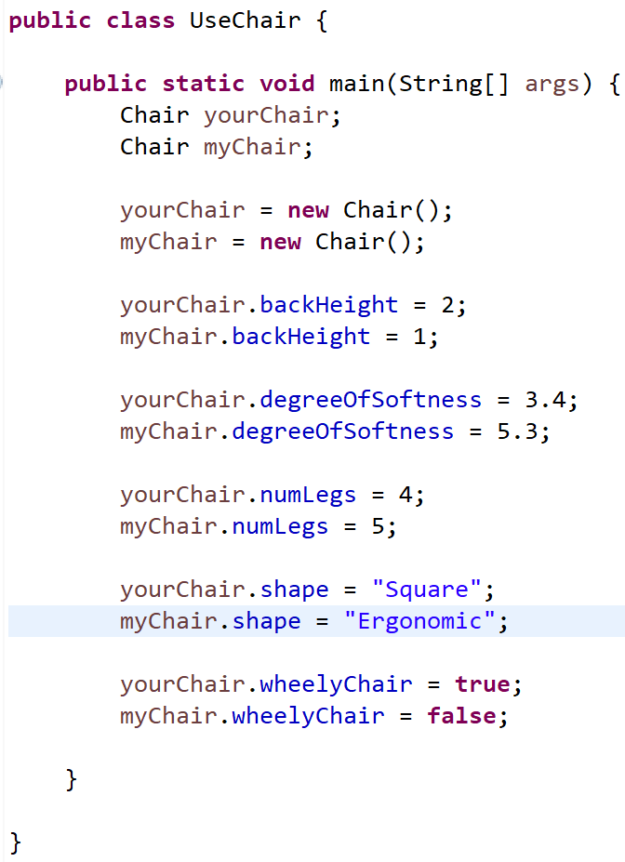
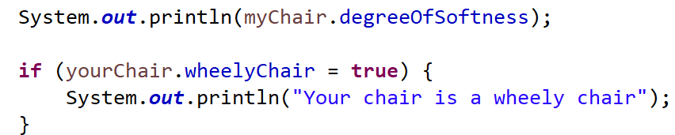
Lesson 11: OOP
Once we have created the two Chair objects, we can then change the values of the characteristics of the chair by doing the following –
As you can see in my code so far I am accessing fields of each chair object, and am setting them to values
We can also use these fields to do different things
For example, we can print the values of each field, or use them as the condition of an if statement

Slide 6

Lesson 11: OOP
Note
Just like we could declare a primitive data type variable (int, char, boolean etc.) by stating what is below we do the same thing with objects. It is the same but different

Slide 7
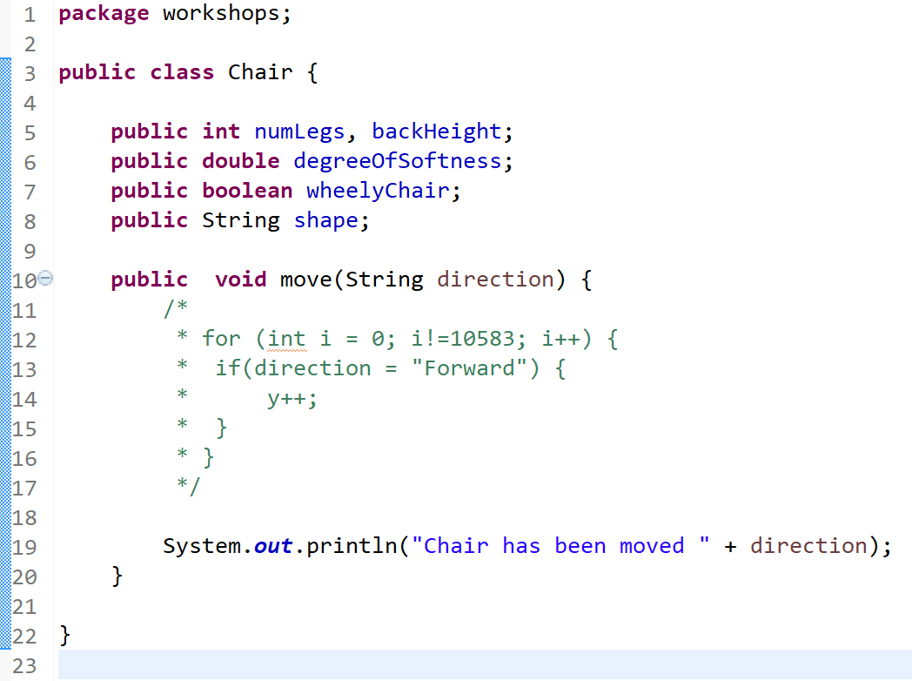

Lesson 11: OOP
Do you all remember methods from the end of last term? They are a set of instructions that do things, and because of their modularity, they can be used in loops to perform instructions over and over again, and can simply clean up your code so it is easier to read
Objects like this chair can have their own method! This means that we can tell the chair, or object, to do something

Slide 8
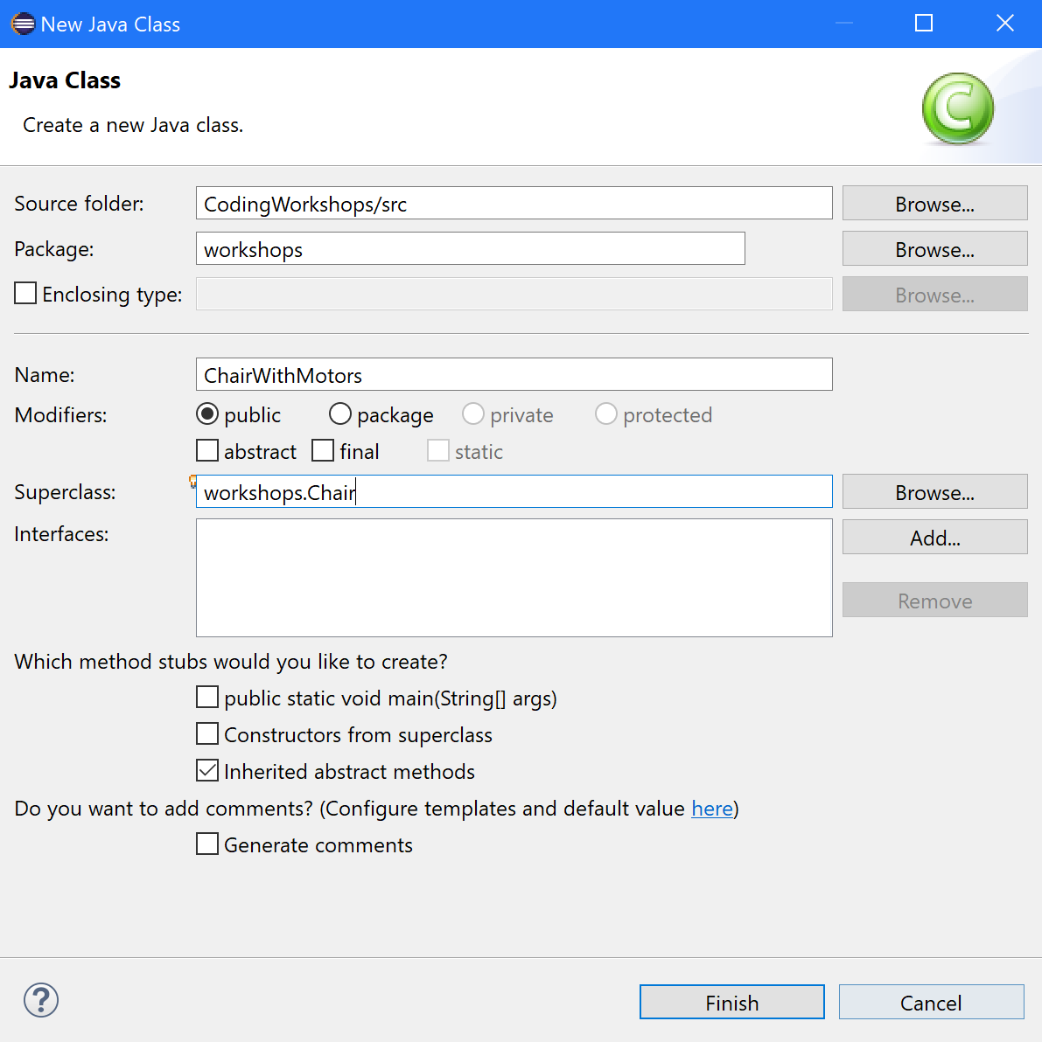
Lesson 11: OOP
But how do we inherit things from another class, like in the bookWithJacket and genericBook classes?
We are now going to create a subclass of the chair class
To begin with we are going to create a new class called ChairWithMotors

Slide 9
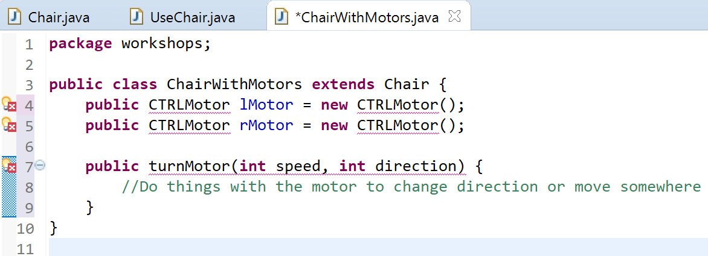
Lesson 11: OOP
To create a subclass of another class, you use the keyword extends, and then the name of the class you want to make a subclass of
Saying it again, this means that the ChairWithMotors class now has the same fields and methods as the generic Chair class
You can then add extra fields, methods, and constructors (which I will get to later), to the subclass
So ChairWithMotors is a chair, but with motors as well – in comparison to the generic chair class, which doesn’t have motors

Slide 10
Lesson 11: OOP
Here is a statement that creates a chair object
We know that we are adding Chair data to the variable names yourChair and myChair, or, we are using the constructor of the Chair class to create a new object. Well, what does this mean?
When we ask the computer to create a new object, it finds memory in which to store the object and its characteristics, or fields
A question you might have is, when I create a new object, can I control what’s placed in the object’s fields as well? What if I want to do more then just fill fields, say, whenever a Chair object is created, I want it to carry out a whole list of other jobs
I am going to tell you about constructors
If you didn’t get that, A constructor tells the computer to perform the start-up tasks of a new object

Slide 11
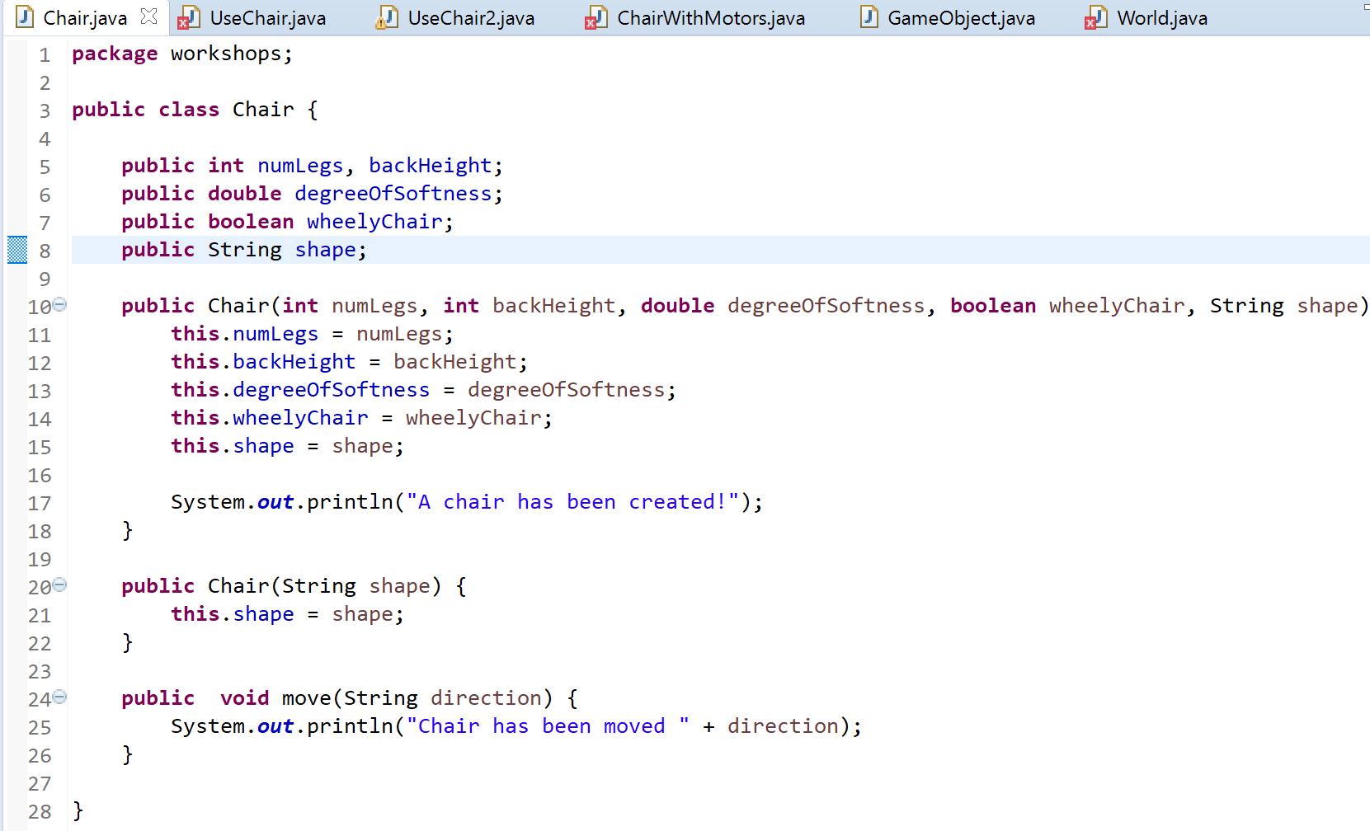
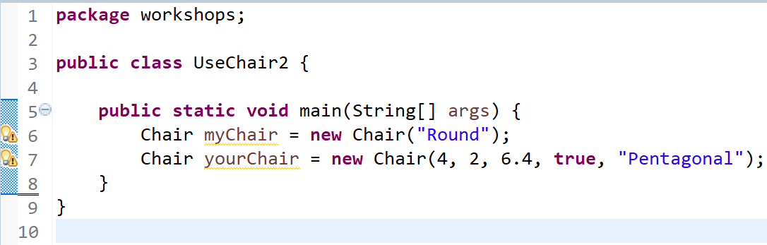
Lesson 11: OOP
Here we can see method-like things that have the name Chair, the same name as the class
These are called constructors
Inside the constructors we are setting the values of the object in its setup, rather then doing it manually ourselves
We can have multiple constructors with different parameters and the same name, but dependant on what parameters we put in the constructor when we make the object, it uses a different constructor
For example, if I were to make a Chair using only a String as the parameter, it would create the object but only with its shape field specified. But if I were to use all the fields in the constructor parameters, it would set all the fields in the new chair object to something
*Remember “this.”, it refers to the fields in an object. Here “this.numLegs” refers to the field, and “numLegs” refers to the constructor parameter.

Slide 12

Lesson 11: OOP
You probably have questions about that, so ask them now:

Slide 13
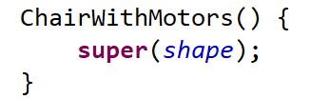
Lesson 11: OOP
A few more Notes
Subclasses do not inherit their parents constructors unless you tell them to
To tell a subclass to inherit a constructor you would write something like this (below) which would tell the subclass to find the parent’s constructor with the parameter shape, and copy whatever it does
Sometimes it may look like an object is inheriting a constructor, but this case is using the default constructor. This occurs if you define no constructors in the subclass, it automatically steals the parameter-less constructor of the parent class

Slide 14

Lesson 11: OOP
Finally, what is static? We have seen it littered throughout our code, but don’t know what it is. We now have sufficient knowledge to find out what it is
If you create something that is static, it remains the same throughout every instance of the class – it is not specific to a certain object
If I were to change a static variable, it would change inside every object.
Static variables, or fields, or methods etc. are specific to a class and not an object
This means that the shape field in the chair class will be the same across every instance of the chair object
Just like fields, static methods can be created, which are, again, specific to the class and not the object

Slide 15
Lesson 11: OOP
Yay! We now have a basic understanding of what Object Oriented Programming is and how to use it in Java
Now do some of the activities that you will find here
Activities
Create an Animal class that has whatever attributes that you want it to
Create an Animal object inside a separate class containing a main method
Do things with this animal object, use its fields as conditions of If statements and print out values
Now create a subclass of the animal object that is a type of animal, like fish, insects, arachnid or whatever
Do a few things with this subclass, like add new fields and methods
Then, add multiple constructors to the animal class, and use them to create new animals
Inherit a constructor from the parent animal class in the animal subclass
Create a static field inside the parent animal class, and do something with it
Do all of these activities again without notes :P
Continue asking questions! This is really complicated and you will just get confused if you don’t ask questions.
I am here to help :D

